Slide 1

News Topic Identification
with NLP
Yuanshan Zhang, Mengxin Zhao, Yahui Wen, Yiming Wang, Jiayun Liu

Slide 2
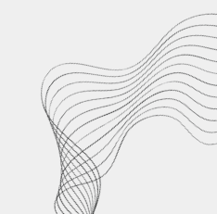
Problem Definition & Motivation
Issue:
Unclassified/Missing label documents’ predominant presence
Costly in time, monetary and manpower
Inscalable
Motivation:
Point a possible direction of model building
Run through NLP models
Evaluate performance with sklearn
Integrate with SML and deep learning

Slide 3
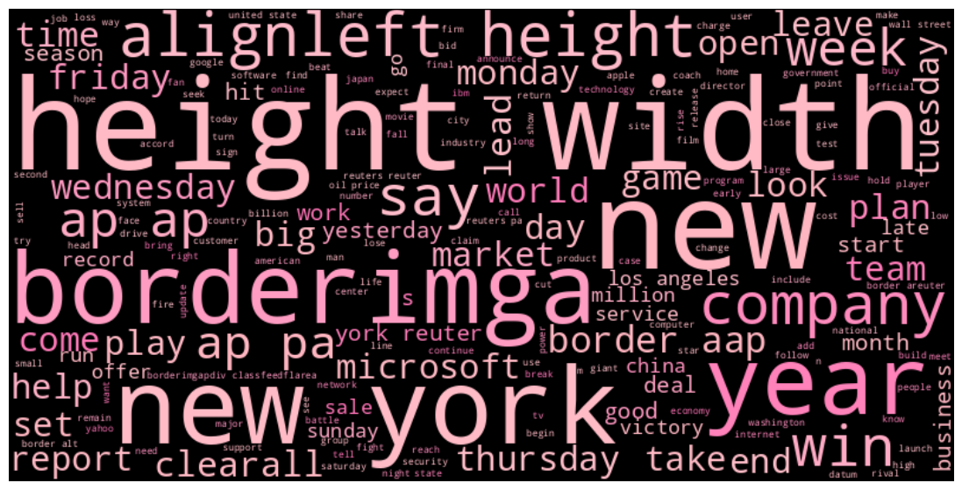
Dataset Info
Archived from AG News corpus
Collected by Antonio Gull
14 classes, each with 30,000 training instances and 1,900 test instances
Sampled data for analysis
Business, Entertainment, Sports, and Sci/Tech
5000 instances from each class

Slide 4
Methods Application
Sampling & cleaning
Tokenization
Vectorization
Sample 5000 records of each category
Keep only lowercase letters and single space
Lemmatization
Remove stopwords
BoW
N-gram
TF-IDF
Embedding
Model Building
Deep Learning
Word2Vec
TF-IDF weighted averaging
Doc2Vec
RandomForest
Logistic Regression
XGBoost
SVM
NaiveBayes
LSTM
Simple RNN

Slide 5
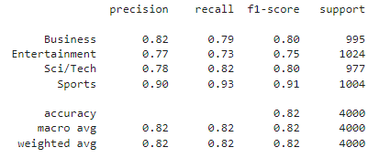
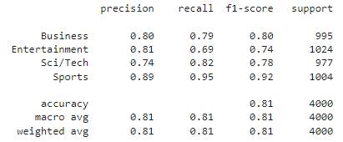
Results
TF-IDF in SVM
Best model: TF-IDF in SVM
Best overall: GloVe 100
Most accurate category: Sports
GloVe in SVM

Slide 6
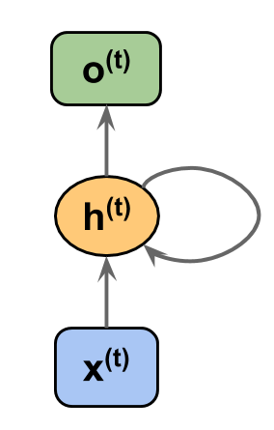
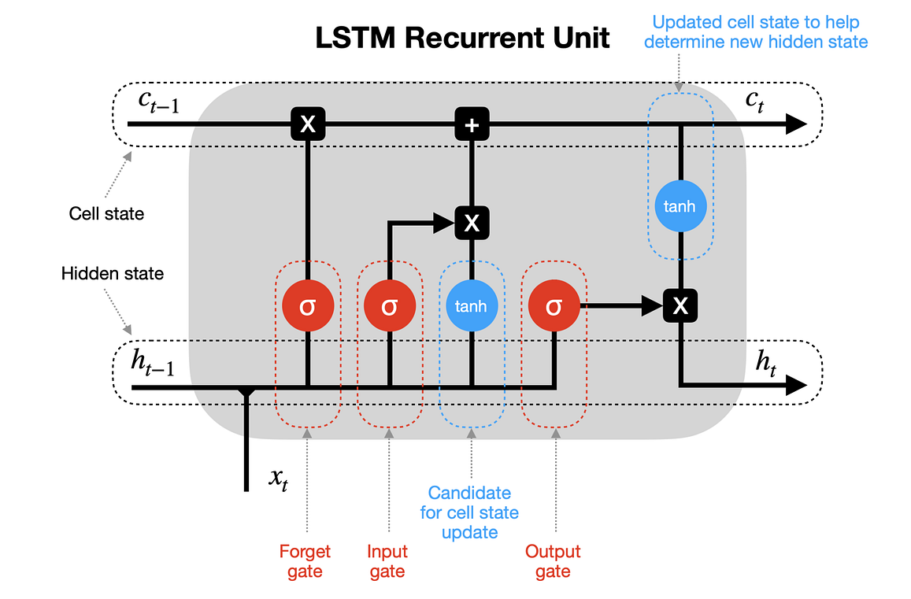
Deep Learning
Simple RNN (Recurrent Neural Network)
LSTM
Gradient Explode/Vanishing • Cannot memorize early information • Happens when sequence length > 100
Long Short-Term Memory • Able to capture long-term dependency • Able to handle with short term task
Notes:
The fundamental technique that today’s LLMs are built upon is the RNN. However, it is hard for RNN to keep track of early information due to gradient explode/vanishing issue. This happens when the sequence length, or say, time step greater than 100. LSTM partially fixes this problem with gate control, thereby being called Long Short-Term memory. To put theory into practice, we built a CNN and RNN to perform classification and compared their results.
The fundamental technique that today’s LLMs (Large Language Models) are built upon is the RNN (Recurrent Neural Network). However, it is hard for RNN to keep track of early information due to gradient exploding/vanishing issues. This usually happens when the sequence length (i.e. time step) is greater than 100. LSTM (Long Short-Term Memory) partially fixes this problem with gate control, thereby being called Long Short-Term Memory. To investigate the differences between these deep learning techniques, we built 2 LSTMs using with transfer learning method (i.e. W2V) and embedding method (i.e. embedding is performed on the embedding layer) and 1 RNN

Slide 7
Preprocessing
Embed tokens into fixed-size vectors (n_dim << n_tokens)
‘I’ → [0.2, 0.1], ‘am’ → [0.8, 0.63], ‘batman’ → [0.33, 0.99]
For each document, arrange vectors to form sequence
[‘I’, ‘am’, ‘batman’] → [[0.2, 0.1], [0.8, 0.63], [0.33, 0.99]]
Pad sequences so that all documents have the same length (suppose 5)
[[0.2, 0.1], [0.8, 0.63], [0.33, 0.99]] → [[0.2, 0.1], [0.8, 0.63], [0.33, 0.99], [0, 0], [0, 0]]
One-hot encode the target
[‘Business’, ‘Entertainment’, ‘Sci/Tech’, ‘Sports’] → [[1,0,0,0], [0,1,0,0], [0,0,1,0], [0,0,0,1]]

Slide 8
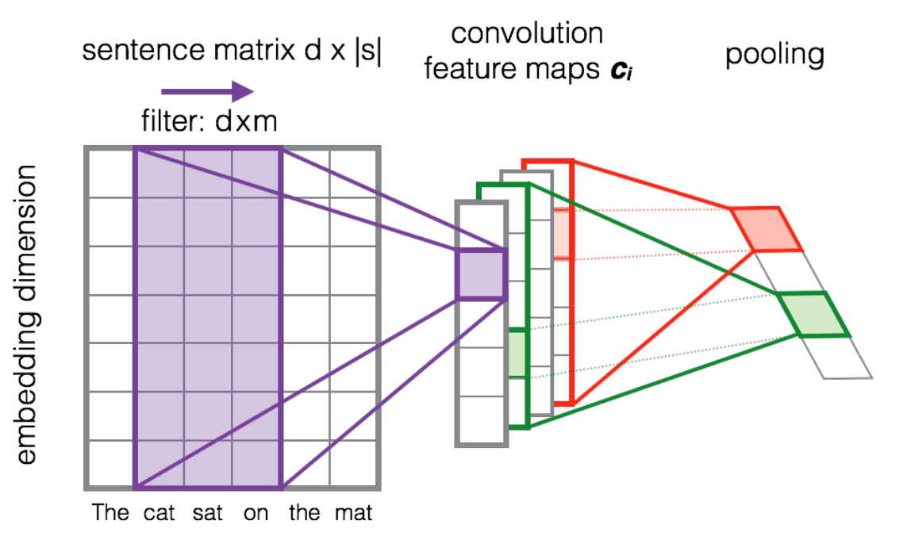
Convolution and Max Pooling
90 time steps
100 features/step
21 time steps
128 features/step

Slide 9
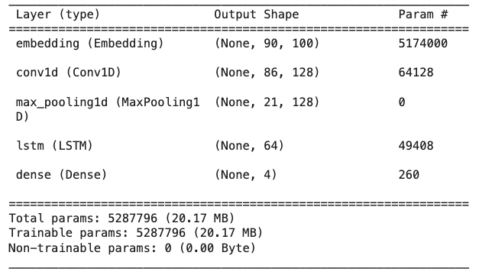
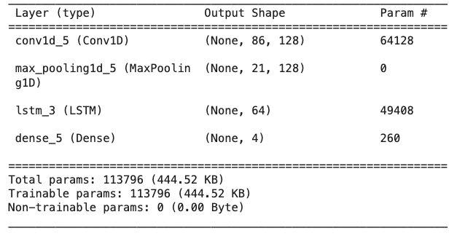
Structure Design
Transfer Learning (LSTM with W2V)
LSTM with an embedding layer
same
accuracy: 0.7723 - val_accuracy: 0.7063
accuracy: 0.9945 - val_accuracy: 0.7566
The embedding layer maps each token to a fixed-size vector, thereby having 5 million more parameters to train!

Slide 10
Structure Design
Transfer Learning (LSTM with W2V)
LSTM with an embedding layer
same
accuracy: 0.7723 - val_accuracy: 0.7063
accuracy: 0.9945 - val_accuracy: 0.7566
• Converges faster • Less accurate
• Converges slower • More accurate
• Tend to overfit
Notes:
Training the vectorization using the data itself better adapts the model to the linguistic usage specific to the task at hand.

Slide 11
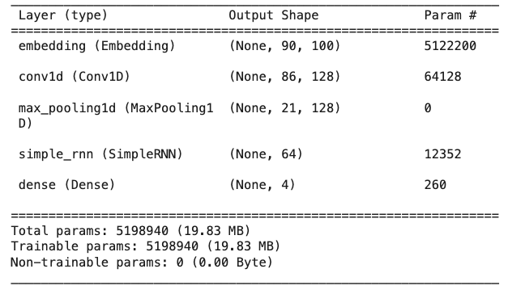
Structure Design
RNN
LSTM with an embedding layer
accuracy: 0.9841 - val_accuracy: 0.7225
accuracy: 0.9945 - val_accuracy: 0.7566
• Less parameters than LSTM • Tend to overfit
• Suitable for time step < 100
• Converges slower • More accurate
• Tend to overfit

Slide 12
Conclusion
TF-IDF combined with SVM emerges as the best-performed model, achieving an accuracy of 0.82.
GloVe model has demonstrated a comparable accuracy of 0.81 with a vector dimension of only 100, proves that as a pre-trained model, GloVe can understand the meaning of text data very well.
Traditional ML models using TF-IDF or pre-trained models such as GloVe could outperform deep learning models. Possible reasons can be:
1. Sample size is too small.
2. The context might not be very complex.
3. Didn’t design a sophisticated network structure for the deep learning model: using convolution and pooling layers to extract features reduce the information we have.
Business Application: Analyzing news titles and descriptions facilitates sentiment analysis, trend analysis, and risk assessment.

Slide 13
Challenge
Switching from Food Recipe Review to AG news since the variable planing to be used for evaluation is inconsistent with the sentiment of the reviews.
Colab crashing, try to minimize the frequency of storing outputs into variables to reduce computational cost and optimized the cell block for Word2Vec and TF-IDF.
Hard to conduct EDA since it’s pure text data, tried to visualize tokenized word frequency distributions and create word clouds for EDA.

